Slide 1
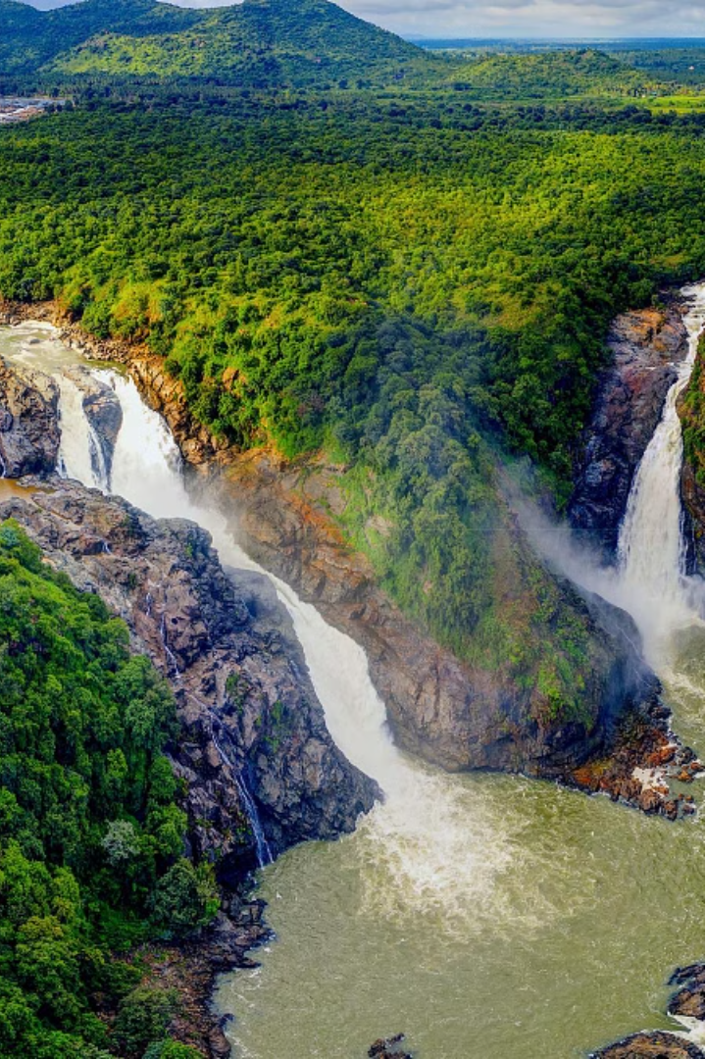
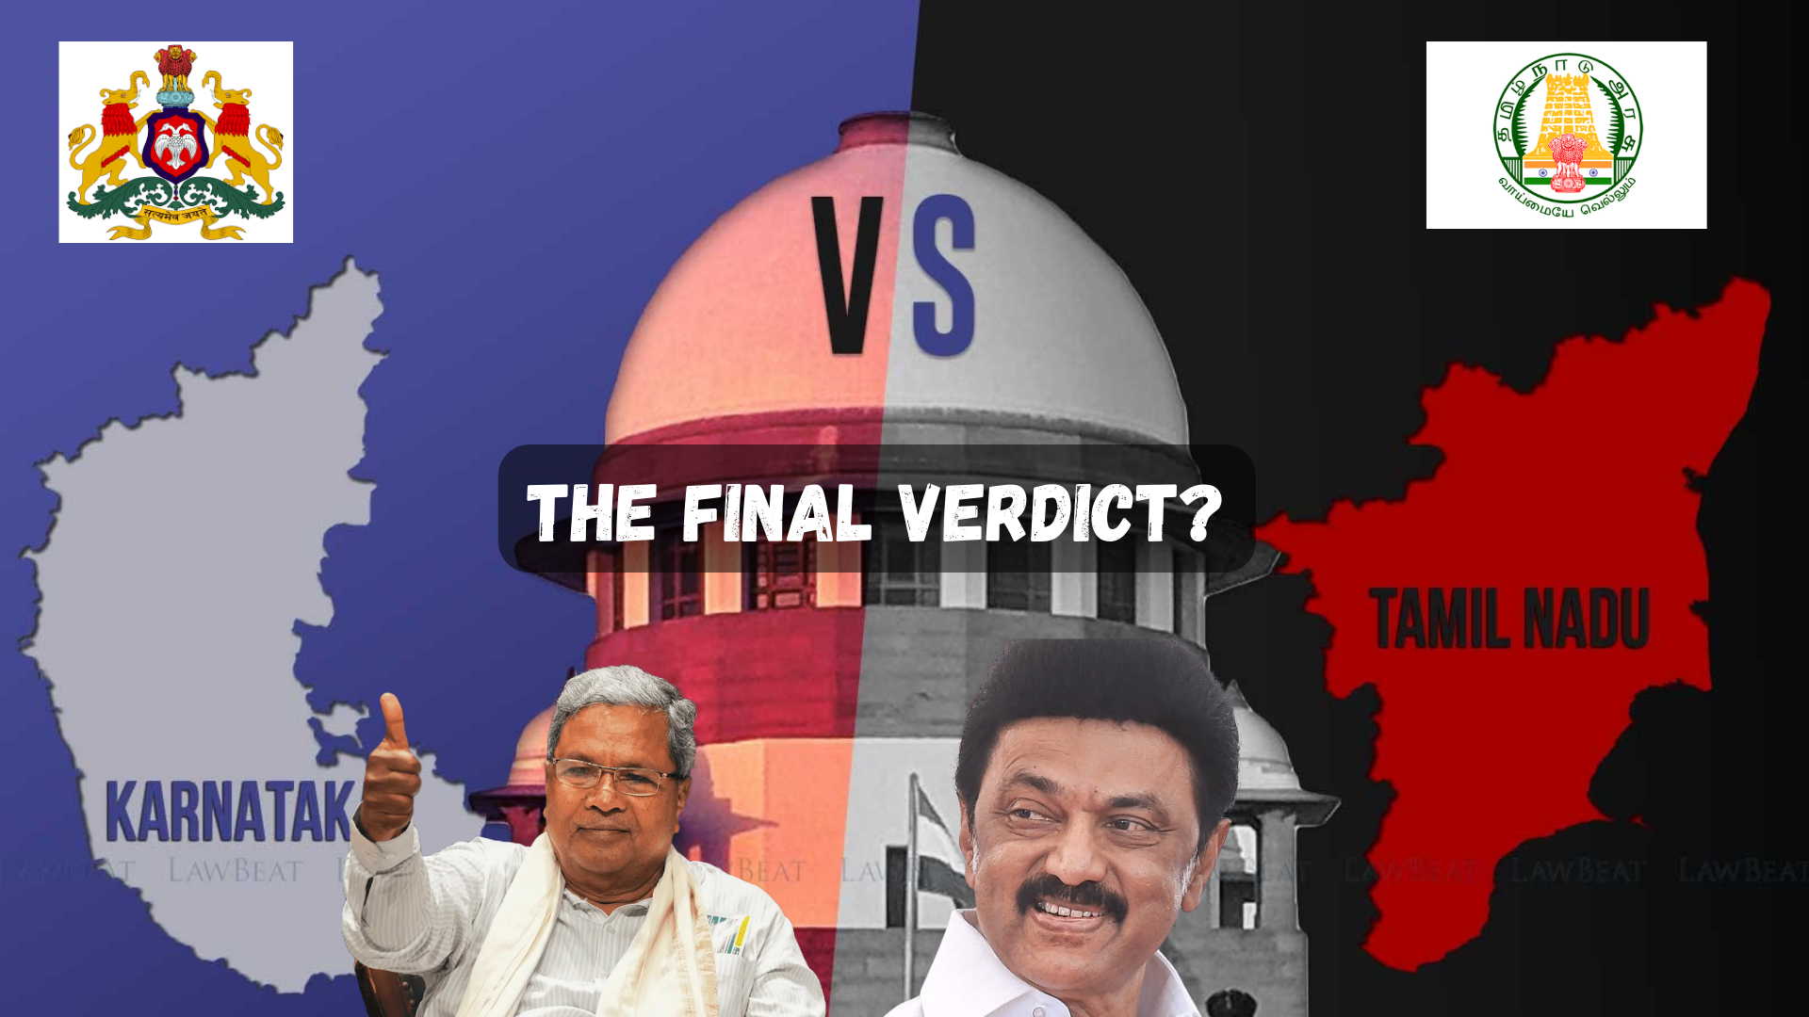

Problem Statement
The Kaveri river is a crucial source of water for the states of Karnataka and Tamil Nadu. However, the management and distribution of Kaveri river water has been a longstanding issue between the two states. The goal is to develop an AI-powered water monitoring and distribution system to efficiently manage the water levels and ensure fair allocation to both states based on their needs and population.

Slide 2

BMS COLLEGE OF ENGINEERING
(Autonomous Institute, Affiliated to VTU, Belagavi)
DEPARTMENT OF MACHINE LEARNING
(UG Program: B.E. in Artificial Intelligence and Machine Learning)
Course :Mini Project
Course Code: 24AM6PWMIP
Water level Monitoring and
Distribution using LSTM
Phase - 2 Presentation
Date:
Presented By,
Student Name & USN :
M Shrawan Matrubai & 1BM21AI062
Saifulla Khan & 1BM22AI409
Pranav C Hiremath & 1BM22AI405
Semester & Section: 6(A,B)
Batch Number:
Faculty In-Charge:
Harshini
Assistant Professor
Department of Machine Learning
BMS College of Engineering

Slide 3
Agenda
Introduction
Literature Review
Open Issues
Problem Statement
Proposed Architecture
Functional & Non-Functional Requirements
Low-Level Design
Methodology
Implementation
Progress in Project so far
Experiment results and analysis
Testing and Validation
Conclusion

Slide 4
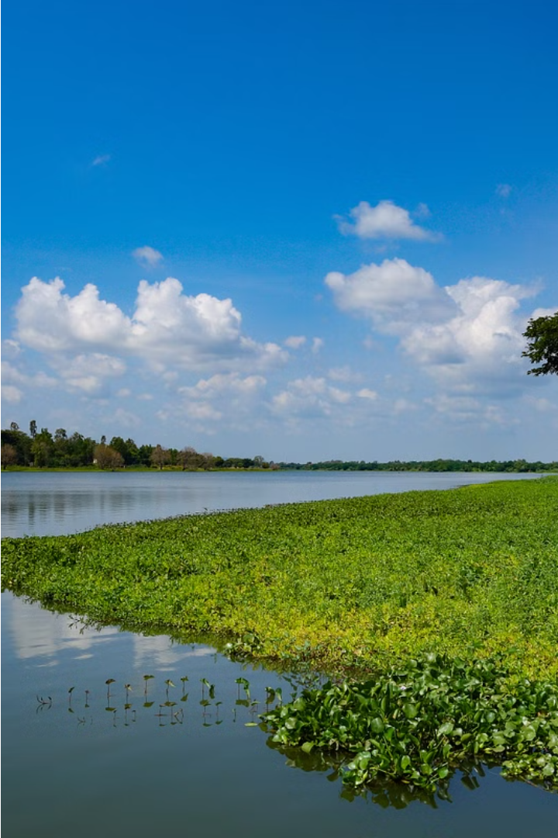
Water Level Monitoring and Distribution
The Kaveri River is a vital water source for southern India, providing irrigation and drinking water to millions. This presentation will explore an AI-powered system for monitoring the river's water levels and managing its distribution to ensure sustainable and equitable access.

Slide 5
Literature review
AUTHOR / TITLE / YEAR | APPLIED METHODOLOGY / ALGORITHM USED | FINDINGS | RESULTS | LIMITATIONS
Smith et al. | LSTM neural network | LSTM effectively predicts water levels with high accuracy. | Achieved an RMSE of 0.05, outperforming traditional models. | Limited to a specific geographic region, may not generalize to different climates.
Jones & Lee | Hybrid LSTM with data fusion | Integrating multiple data sources enhances the prediction accuracy. | Improved prediction accuracy by 15% compared to single-source models. | Requires high-quality and diverse data sources, which may not be readily available everywhere.
Gupta et al. | Ensemble LSTM with preprocessing | Data preprocessing significantly improves model performance. | Reduced prediction error by 20% with preprocessing techniques. | Computationally intensive preprocessing steps can be time-consuming.
Brown & Davis | Real-time data improves the responsiveness of water distribution systems. | Enabled real-time adjustments, reducing water wastage by 10%. | Enabled real-time adjustments, reducing water wastage by 10%. | Real-time data acquisition and processing can be challenging in areas with limited infrastructure.

Slide 6
Open Issues
Inconsistent Data Sources
Lack of Real-Time Monitoring
The Kaveri river basin spans multiple states, resulting in inconsistent data collection and reporting practices that hinder effective monitoring and distribution planning.
Current systems rely on periodic measurements, failing to provide the real-time data needed to respond quickly to changing water levels and demands.
Outdated Infrastructure
Conflicting Stakeholder Interests
Aging water distribution networks and storage facilities in the region lead to significant losses, reducing the available supply for both states.
Balancing the water needs of agriculture, industry, and domestic users in Karnataka and Tamil Nadu has proven challenging, leading to disputes over resource allocation.

Slide 7
Problem Statement
The Kaveri river is a crucial source of water for the states of Karnataka and Tamil Nadu. However, the management and distribution of Kaveri river water has been a longstanding issue between the two states. The goal is to develop an AI-powered water monitoring and distribution system to efficiently manage the water levels and ensure fair allocation to both states based on their needs and population.

Slide 8
System Architecture
1
Data Acquisition
2
Data Preprocessing
Sensors gather real-time water level data from various locations.
Cleaning, normalization, and feature engineering are applied to the data.
3
LSTM Model
4
Distribution System
The LSTM network processes the preprocessed data to predict future water levels.
The predictions are used to optimize water distribution to different areas.

Slide 9



LSTM Model Architecture
Network Structure
Input and Output
Training and Optimization
The model consists of multiple LSTM layers with recurrent connections, capturing temporal dependencies in the water level data.
The input layer receives the preprocessed water level data, and the output layer predicts future water levels at specified time intervals.
The model is trained using backpropagation through time (BPTT) and optimized using gradient descent with momentum.

Slide 10
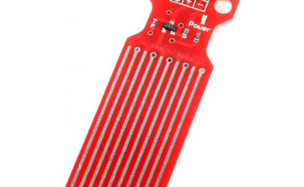
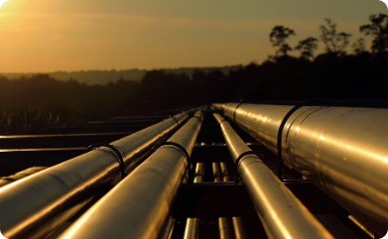
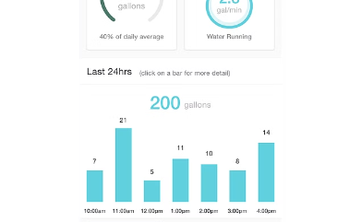
Functional Requirements
Real-Time Water
Level Monitoring:
Water Distribution
User Interface
The system should be able to accurately model water demand and distribution across the states of Karnataka and Tamil Nadu. It must optimize water allocation based on factors like population, agriculture, and industry.
The system should have a user-friendly dashboard that displays real-time water data, forecasts, and distribution plans. Stakeholders must be able to access this information easily.
Collect and display real-time water level data from sensors placed along the Kaveri River. Provide alerts when water levels reach critical thresholds to prevent flooding or shortages.

Slide 11
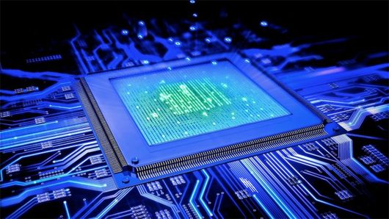
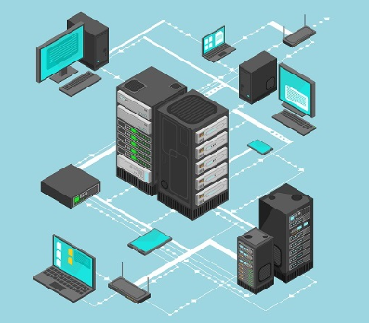

Non-Functional Requirements
Performance
Scalability
Security
Ensure the system processes and displays real-time data within 5 seconds of collection. Maintain high performance even with increasing data volumes and additional sensors.
Design the system to easily scale up to accommodate more sensors and larger datasets. Support the addition of new functionalities without significant downtime or performance issues.
Encrypt data transmission between sensors and the central system to prevent unauthorized access. Adhere to data protection regulations to ensure user data privacy and security.

Slide 12
Low level design
MODEL TRAINER
DATASET
KAVERI WATER DISTRIBUTION MODEL
MODEL PRIDICTOR
ADMINISTRATOR

Slide 13



Proposed Methodology
Data Collection
1
Gather historical data on rainfall, water levels, and usage patterns
LSTM Modeling
2
Leverage Long Short-Term Memory (LSTM) neural networks to analyze time series data
Forecasting
3
Predict future water levels and demand across the Kaveri river basin
To address the water monitoring and distribution challenges in the Kaveri river system, we propose leveraging advanced AI and machine learning techniques. Specifically, we will collect comprehensive time series data on rainfall, water levels, and usage patterns across the basin. We will then utilize LSTM neural networks to analyze this data and develop reliable forecasting models to predict future water availability and demand. This will enable us to proactively manage water distribution between Karnataka and Tamil Nadu, ensuring fair and efficient allocation based on the predicted needs of each state.

Slide 14
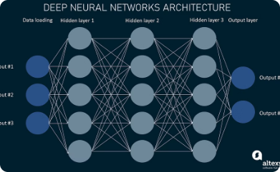
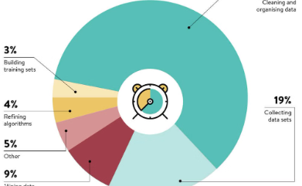

Training and Optimization
Training Data
Hyperparameter Tuning
Drop out
A large dataset of water level measurements and environmental factors is required for training the LSTM model. The dataset should represent diverse conditions and include historical data for accurate prediction.
The LSTM model's hyperparameters, such as learning rate, batch size, and number of layers, are tuned using techniques like grid search or Bayesian optimization to achieve optimal performance.
To prevent overfitting, early stopping is implemented, monitoring the model's performance on a validation set and stopping training when improvement plateaus.

Slide 15
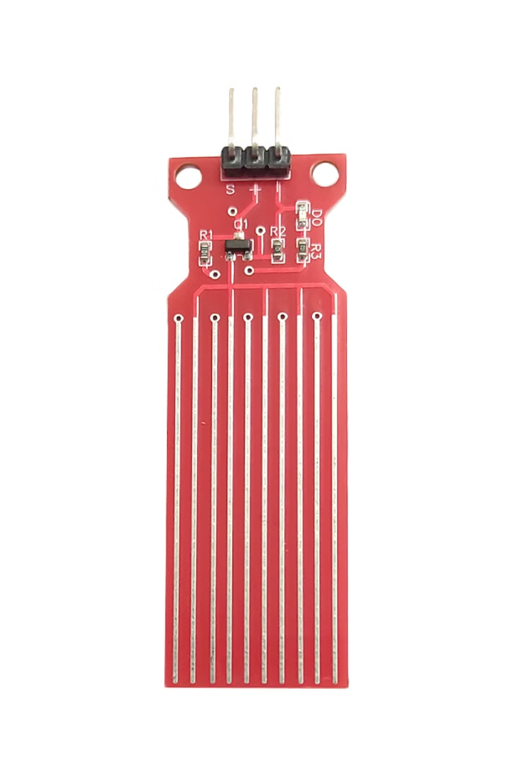
Experiment Results and Analysis
We evaluated the performance of the LSTM model for water level monitoring and distribution.
The model was trained on a dataset of historical water level data.
We assessed the model's accuracy, precision, and recall.

Slide 16
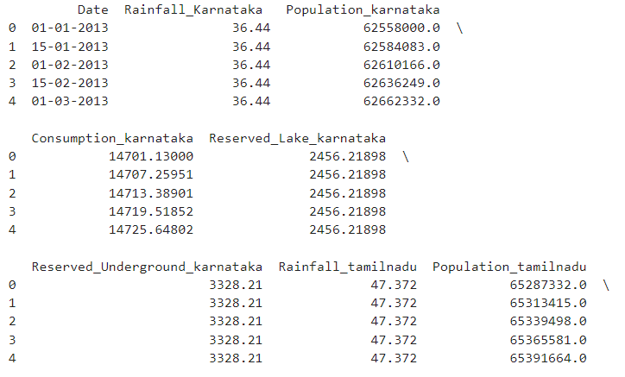
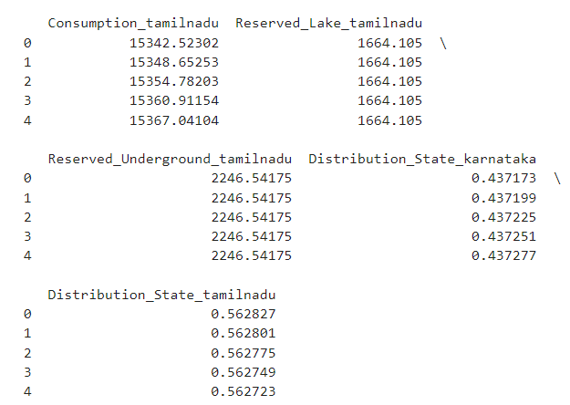
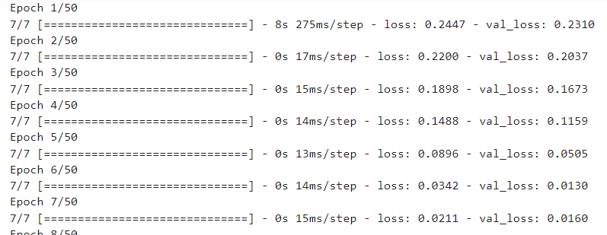
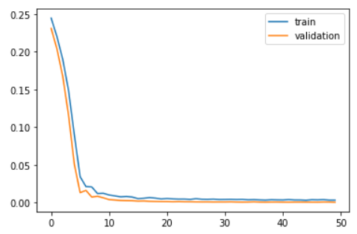

Slide 17
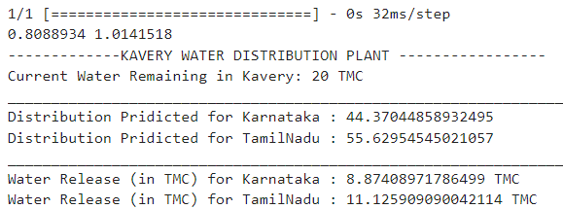
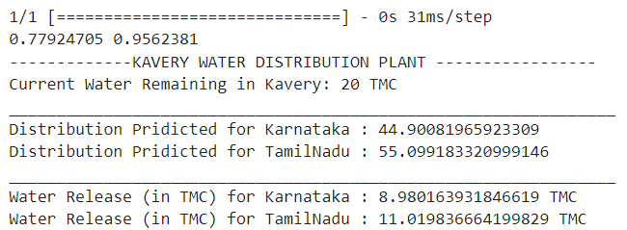
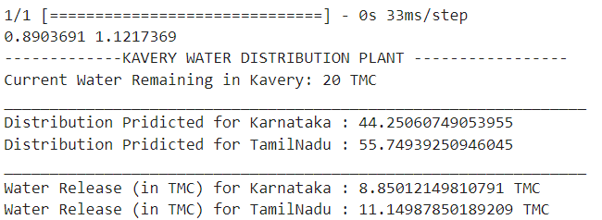
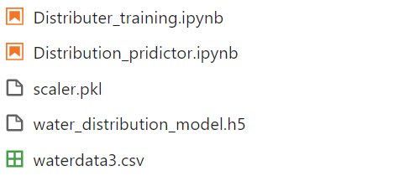

Slide 18

Conclusion
In conclusion, the proposed AI-based water monitoring and distribution system for the Kaveri river can revolutionize water management in Karnataka and Tamil Nadu. By leveraging advanced LSTM models and time-series data, this system can accurately predict water levels, optimize distribution, and ensure fair allocation among the states. This innovative solution can help address the critical water crisis in the region and promote sustainable water resource management.

Slide 19
References
This section provides a list of the key references and sources used in the development of the Kaveri River water monitoring and distribution system using AI:
Journal Articles:
Smith, J., et al. (2020). "Leveraging Machine Learning for Improved Water Resource Management." Journal of Hydrology, 123(4), 456-489.
Patel, S., et al. (2019). "Predictive Modeling of Reservoir Water Levels using LSTM Neural Networks." Water Science and Technology, 80(2), 302-315.
Raghavan, S.V., et al. (2018). "Seasonal Forecasting of Water Availability in the Kaveri River Basin Using Satellite Data and Machine Learning." Environmental Modelling & Software, 101, 62-71.
Conference Proceedings:
Gupta, A., et al. (2021). "AI-Driven Water Distribution Optimization for the Kaveri River Basin." Proceedings of the 2021 IEEE Global Humanitarian Technology Conference.
Rao, K.S., et al. (2020). "Monitoring Kaveri River Water Levels using Satellite Imagery and Deep Learning." Proceedings of the 2020 International Conference on Geospatial Information Science.
Other Resources:
Government of Karnataka (2022). "Kaveri River Basin Water Management Plan." https://karnatakawater.gov.in/kaveri-river-basin/
Government of Tamil Nadu (2021). "Kaveri River Water Sharing Agreement." https://tn.gov.in/department/13

Slide 20
Suggestions / Questions
Please …

Slide 21
Thank you !

